Slide 1
Integrated Crop Protection Management
PIP2001 CAPSTONE PROJECT
Batch Number: PSCS139
Roll Number | Student Name
20211CSE0003 | N.JagadeeshChandra Brammeswararao
20211CSE0011 | N.Venkatesh Raju
20221LCS0001 | A.Varun Kumar
Under the Supervision of,
Dr. Naveen N M
Associate Professor
School of Computer Science and Engineering
Presidency University

Slide 2
Introduction
Agriculture is the backbone of many economies worldwide, and farmers play a pivotal role in ensuring food security and economic stability. However, farming comes with its challenges, including the need to make informed decisions about crop selection, soil suitability, and optimizing agricultural practices. To address these challenges and empower farmers, we introduce the Crop Recommendation Android application. The Crop Recommendation app is a cutting-edge solution developed using Android Studio, designed with the primary goal of assisting farmers in making well-informed decisions for their agricultural activities.
In today's technology-driven world, it is crucial to harness the power of innovation to enhance productivity and profitability in the agricultural sector. This app bridges the gap between traditional farming practices and modern technology, ensuring that farmers have access to valuable insights and recommendations at their fingertips. One of the key features of this app is its ability to predict soil suitability for different types of crop growth. By allowing farmers to upload photographs of their soil, the app utilizes deep learning algorithms to accurately identify the type of soil, a critical factor in crop selection.

Slide 3
Literature Review
Existing Method:
The existing system lacks efficiency and accuracy in assessing soil suitability. It relies heavily on manual methods, making it time-consuming and prone to human error. Farmers often struggle to access relevant information on crop optimization. it does not incorporate user-friendly technology, hindering seamless interaction and decision-making for farmers.
Disadvantages in Existing method:
Farmers face challenges in accessing timely information about soil suitability and crop optimization.
making it less intuitive for farmers.

Slide 4
Research Gaps Identified
Integrated Crop Protection Management (ICPM) is a sustainable approach to pest, weed, and disease control that combines various management strategies and practices. Research gaps in ICPM often arise from the complexity of integrating diverse components and adapting them to local ecological, economic, and social conditions. Below are key research gaps in this field:
Disadvantages:
Complexity of Implementation
High Initial Costs
Time-Intensive
Limited Immediate Effectiveness
Environmental Challenges
Dependence on Research and Local Adaptation

Slide 5
Proposed Method
In this model the friendly Ui is maintain and the easy to understand the recommended crop. These will helpful for the farmers to gain more profit by suggesting proper crop for that land, before framing a new crop. The soil details also very clear and easy to understand for the farmers. The farmers can view news about farmers.
Advantages of Proposed method:
Friendly Ui for easy to understand.
Less algorithms are used for getting more suggestions.
Suggestions are also easy to understand.

Slide 6
Objectives
→Crop Recommendation System for Precision Agriculture
S. Pudumalar, E. Ramanujam, R. Harine Rajshree, C. Kavya, T. Kiruthika, J. Nisha
Data mining is the practice of examining and deriving purposeful information from the data. Data mining finds its application in various fields like finance, retail, medicine, agriculture etc. Data mining in agriculture is used for analysing the various biotic and abiotic factors. In this paper, this problem is solved by proposing a recommendation system through an ensemble model with majority voting technique using Random tree, CHAID, K-Nearest Neighbour and Naive Bayes as learners to recommend a crop for the site-specific parameters with high accuracy and efficiency.
→Intelligent Crop Recommendation System Using ML
Zeel Doshi, Subhash Nadkarni, Rashi Agrawal, Prof. Neepa Shah
This paper, proposed and implemented an intelligent crop recommendation system, which can be easily used by farmers all over India. This system would assist the farmers in making an informed decision about which crop to grow depending on a variety of environmental and geographical factors. We have also implemented a secondary system, called Rainfall Predictor, which predicts the rainfall of the next 12 months

Slide 7
→Analysis of Soil Behaviour and Prediction of Crop Yield using Data Mining
Monali Paul, Santosh K. Vishwakarma, Ashok Verma
This work presents a system, which uses data mining techniques in order to predict the category of the analysed soil datasets. The category, thus predicted will indicate the yielding of crops. The problem of predicting the crop yield is formalized as a classification rule, where Naive Bayes and K-Nearest Neighbour methods are used.
→Crop Selection Method to Maximize Crop Yield Rate using Machine Learning Technique.
Rakesh Kumar, M.P. Singh, Prabhat Kumar and J.P. Singh
This paper proposed a method named Crop Selection Method (CSM) to solve crop selection problem, and maximize net yield rate of crop over season and subsequently achieves maximum economic growth of the country. The proposed method may improve net yield rate of crops.
→Development of Yield Prediction System Based on Real-time Agricultural meteorological Information
Haedong Lee, Aekyung Moon, Gajeong-ro, Yuseong-gu
This paper contains about the research and the building of an effective agricultural yield forecasting system based on real-time monthly weather. It is difficult to predict the agricultural crop production because of the abnormal weather that happens every year and rapid regional climate change due to global warming. The development of agricultural yield forecasting system that leverages real-time weather information is urgently required. In this research, we cover how to process the number of weather data (monthly, daily) and how to configure the prediction system. We establish a non-parametric statistical model on the basis of 33 years of agricultural weather information. According to the implemented model, we predict final production using the monthly weather information. This paper contains the results of the simulation.

Slide 8
System Design and Implementation
The input design is the link between the information system and the user. It comprises the developing specification and procedures for data preparation and those steps are necessary to put transaction data in to a usable form for processing can be achieved by inspecting the computer to read data from a written or printed document or it can occur by having people keying the data directly into the system. The design of input focuses on controlling the amount of input required, controlling the errors, avoiding delay, avoiding extra steps and keeping the process simple. The input is designed in such a way so that it provides security and ease of use with retaining the privacy.
Computer output design should be done in an orderly, well-thought manner; the right output must be developed while ensuring that each output element is designed so that people will find the system can use easily and effectively. When analysis design computer output, they should identify the specific output that is needed to meet the requirements. Create document, report, or other formats that contain information produced by the system.

Slide 9
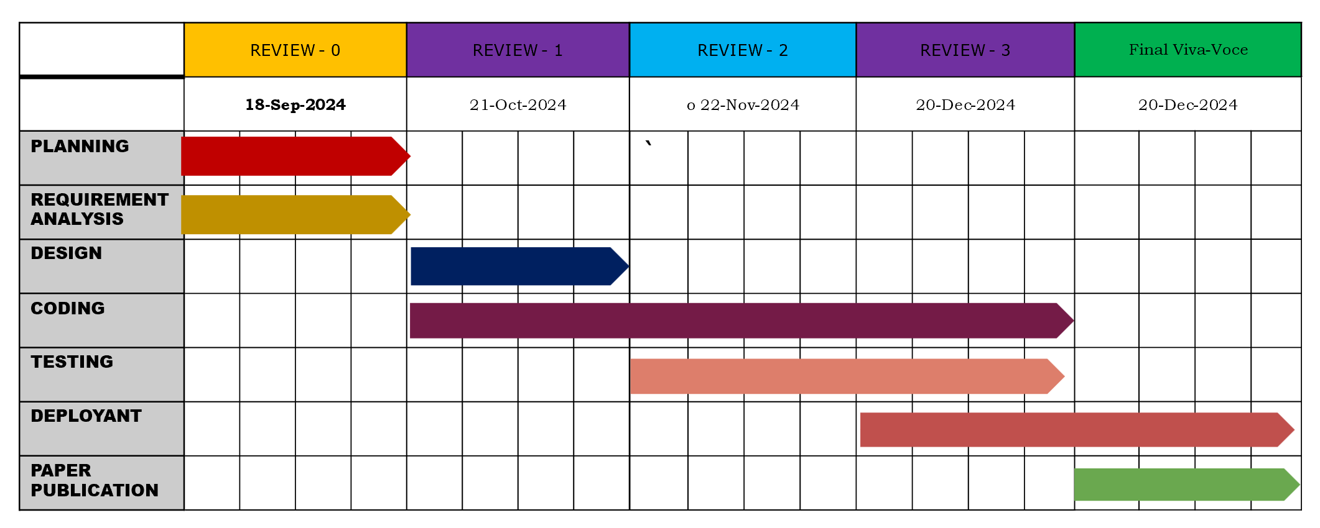
Timeline of Project

Slide 10
Outcomes/Result obtained
→Data-Driven Decision Making
Users will make informed decisions on crop protection strategies based on predictive analytics and real-time data.
→Cost Savings for Farmers
Users experience a reduction in crop protection costs due to efficient use of inputs (pesticides, labor, etc.).
→Personalized Crop Protection Plans
Customized pest management plans based on user input, geographic data, and crop type.
→Higher Profitability
Overall improvement in farm profitability due to better crop protection, cost savings, and increased yields.
→Weather-Based Predictions
Improved pest and disease control through weather-based predictions and recommendations.

Slide 11
Conclusion
The development of a crop protection management app offers a transformative solution for modern agriculture by empowering farmers with real-time data, decision-making tools, and cost-effective strategies to manage pests and diseases. The expected outcomes, such as improved pest monitoring, reduced pesticide use, enhanced sustainability, and increased crop yields, reflect the app's potential to drive significant economic, environmental, and operational benefits. Through personalized recommendations, integration with IoT devices, and accessibility features, the app can provide farmers with an innovative platform that optimizes crop protection, increases profitability, and promotes sustainable farming practices globally.
By addressing key challenges in crop management, the app can become a vital tool in ensuring food security, reducing the environmental impact of agriculture, and improving the overall productivity of farms.

Slide 12
References
S. Pudumalar, E. Ramanujam, R. Harine Rajshree, C. Kavya, T. Kiruthika, J. Nisha. Crop Recommendation System for Precision Agriculture, June 2017
Zeel Doshi, Subhash Nadkarni, Rashi Agrawal, Prof. Neepa Shah Intelligent Crop Recommendation System Using ML, August 2018
Monali Paul, Santosh K. Vishwakarma, Ashok Verma. Analysis of Soil Behaviour and Prediction of Crop Yield using Data Mining, August 2016
Haedong Lee, Aekyung Moon, Gajeong-ro, Yuseong-gu, Development of Yield Prediction System Based on Real-time Agricultural meteorological Information, 305-700
Rakesh Kumar, M.P. Singh, Prabhat Kumar and J.P. Singh Crop Selection Method to Maximize Crop Yield Rate using Machine Learning Technique. May 2015
Jay Gholap, Anurag Ingole, Jayesh Gohil, Shailesh Gargade and Vahida Attar, Soil Data Analysis Using Classification Techniques and Soil Attribute Prediction, International Journal of Computer Science Issues, Volume 9, Issue 3
Suresh, G., A. Senthil Kumar, S. Lekashri, and R. Manikandan. "Efficient Crop Yield Recommendation System Using Machine Learning for Digital Farming." International Journal of Modern Agriculture 10, no. 1 (2021): 906-914.

Slide 13
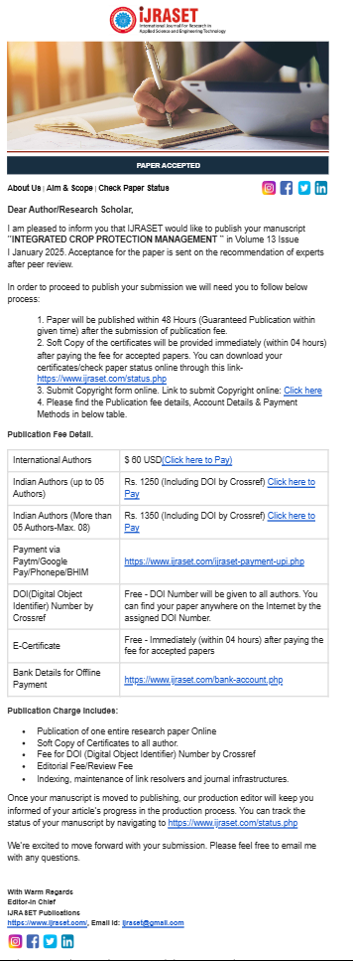
Publication details

Slide 14
Thank You

